Slide 1



CLEAN CODE
A quest to make your code more readable to others - and yourself

Slide 2

WHAT AM I ON ABOUT
First and Foremost
These guidelines are pulled directly from leaders in our practice – however, thoughtful deviations are encouraged
This is only scratching one tiny surface of writing clean code
That’s the spoiler for the summary of the presentation so you can leave if you want

Slide 3
THE CODE YOU WRITE WILL BE READ MORE TIMES THAN IT WAS WRITTEN AND BY MORE PEOPLE.
- Kent Beck | Implementation Patterns

Slide 4
ANY FOOL CAN WRITE CODE THAT A COMPUTER CAN UNDERSTAND. GOOD PROGRAMMERS WRITE CODE THAT HUMANS CAN UNDERSTAND.
- Martin Fowler

Slide 5
FOUR BASIC PRINCIPLES (OF ART)
Contrast
Repetition
Alignment
Proximity
Notes:
So I’ve pulled a little sneaky on ya – these are the principles of Art but the same thing that makes a movie poster, a wall painting, or drawing grab our attention to us is the same thing that makes code stand out and understandable. When these principles are not adhered to, you get jarring, disjointed, and less-than-ideal responses.

Slide 6
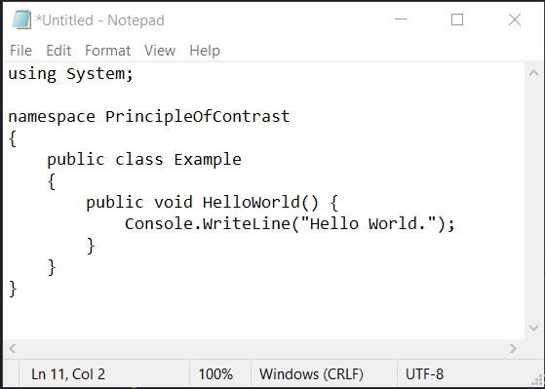
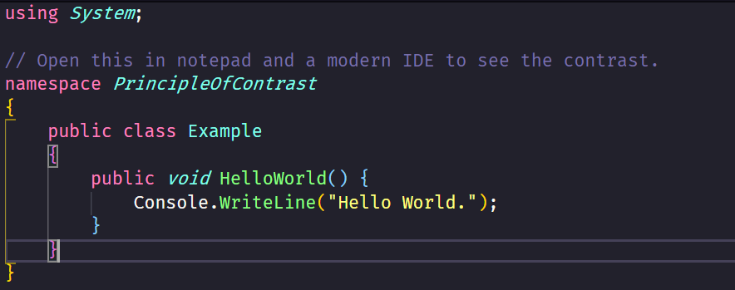
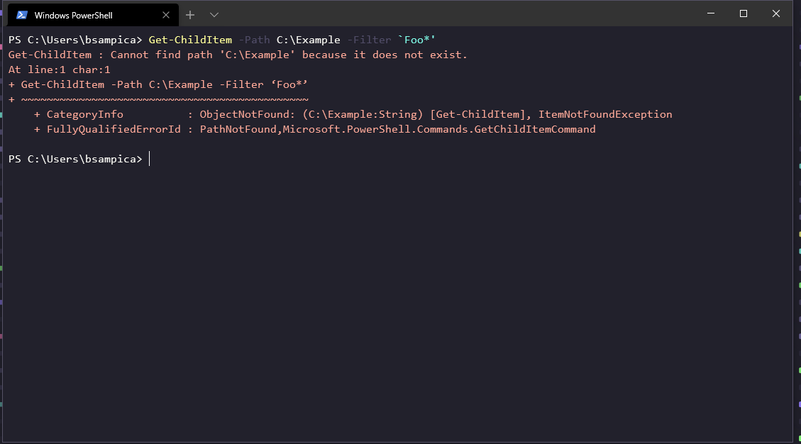
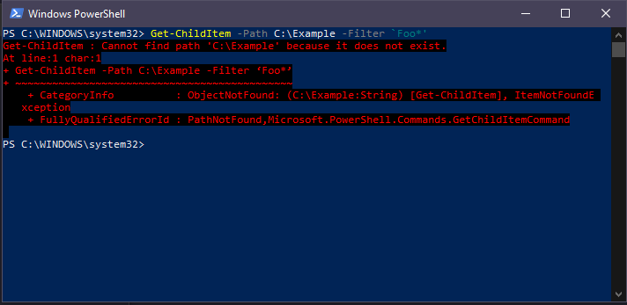
CONTRAST
Objects that contrast each other are easier to understand
Notepad
VS Code (Dracula)
Windows Terminal (Dracula)
Powershell
Notes:
Talk about the stark difference between the two
Nothing was gained – it didn’t make me a better developer starting out in notepad.
It’s horrible and we are all better for it.
Notice the contrast on the VS code picture in particular. Namespaces and return types are italic and cyan. Methods are green, text is yellow. Static classes are white. Even the bracket pairs are colorized by their nested level. These visual cues make reading code so much easier.
There is a non-zero amount of time saved doing this. And also a non-zero amount of bugs caught from these contextual clues.
Upgrade your work life and productivity by upgrading your development tools – starting with finding a theme you like staring at 8 hours a day.

Slide 7
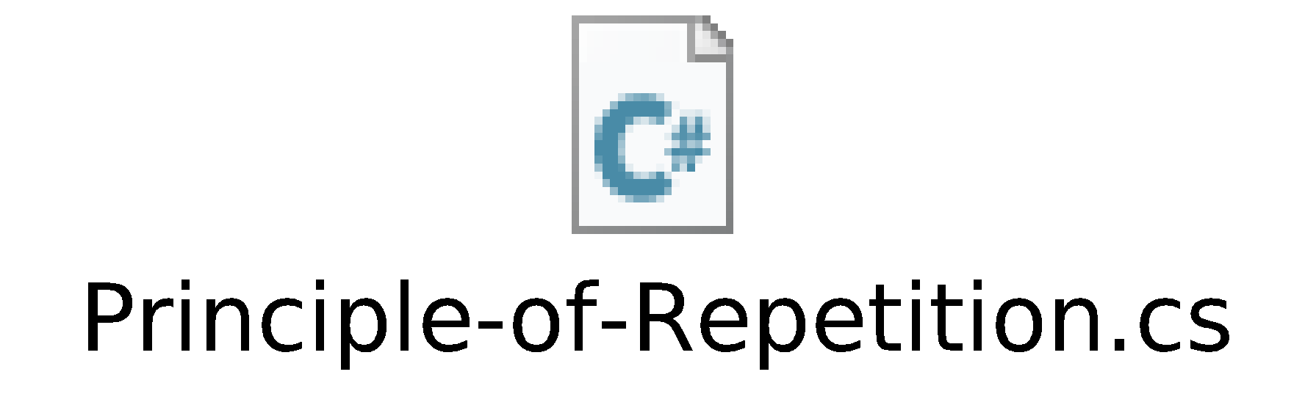
REPETITION
Reusing the same or similar elements through your design
brings a clear sense of unity, consistency, and cohesiveness

Slide 8

ALIGNMENT
Poorly aligned elements look cluttered and unfinished

Slide 9
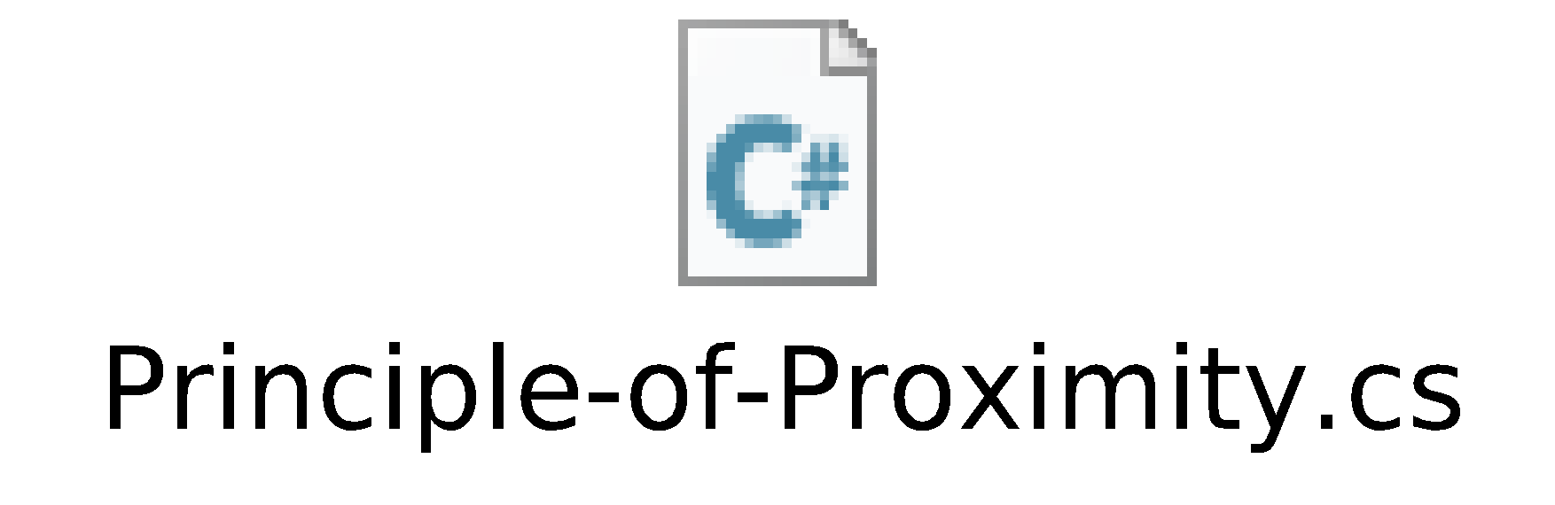
PROXIMITY
Items that are close together are perceived as part of the same group

Slide 10
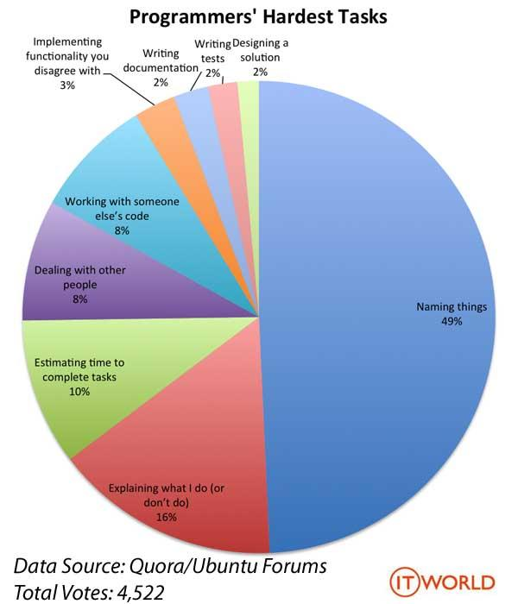
NAMING THINGS IS REALLY FREAKING HARD

Slide 11
BUT WHY?
Names are important for our need to categorize things.
Simplify
Organize
Symbolize
We try to reuse concepts we already know and understand – but what is understood differs between each of us.
Fractured perspectives
Notes:
We are all attending this same tech talk, but the things we get out of it will differ between us. We all had the exact same experience and still have a different perspective.

Slide 12
WHEN YOU’RE HAVING TROUBLE NAMING SOMETHING…
Does it have a single responsibility?
What does a coworker think?
It may be time to extract the method
S of SOLID design
Describe the method to yourself
If you find yourself saying “and/or”, it may be doing too much
Changes to only one part of the software’s specification should be able to affect the class
Having another perspective brings understanding together
Refactor your code and split the field, method, or class into separate parts

Slide 13
REMEMBER TO BE CONSISTENT AND CONCISE
Don’t be clever
Think you’re saving time by abbreviating a variable name?
You’re likely not ☺
Good rule of thumb is not to shorthand anything unless it’s a cultural or accepted acronym
That’s where it gets tricky
It should be a thoughtful decision to introduce new vocabulary into your application.
Using the same terms the business does is a good start
Speaking the same language helps communication
Notes:
All three of these things tie into being consistent and here’s some examples

Slide 14
BE CONSISTENT WHEN…
Naming things
Ordering parameters
Following cultural norms
Is it accountNumber, accountNo, or accountNum?
Pick one and enforce it
Make sure your methods across your domain have their parameters ordered in the same way
The initial order doesn’t matter too much (see cultural norms) as long as you stick to it.
Good example is addresses
When you fill out an envelope you fill out, in order
Line One
Line Two
City
State
Zip
This is embedded in our brains in America
Every website form ever has these fields structured to flow in this same way
Order your parameters this same way
Not doing so is jarring and is deceptive when these are often all string parameters
Lean on your gut but don’t be afraid to ask!
Notes:
- I order pizza a lot – every pizza ordering form is structured with the address the same way.

Slide 15
BE CONCISE WHEN…
Introducing new concepts
Is it a User Detail page or a User Information page?
Likewise, is it the view model for that page a userDetailModel or a userInformationModel?
Pick one for everyone on your team to use and enforce it

Slide 16

WHAT BEHAVIORS CAN YOU ADOPT TODAY?

Slide 17



BEHAVIORAL GOALS
WRITE CODE THAT COULD’VE BEEN WRITTEN BY ANYONE
HAVE A CODE STYLE THAT CAN’T BE EASILY “SMELLED” BY OTHERS
DELIVER CODE WITH THE LONGEST LIFETIME POSSIBLE
Notes:
Code style - Ben wrote this code

Slide 18
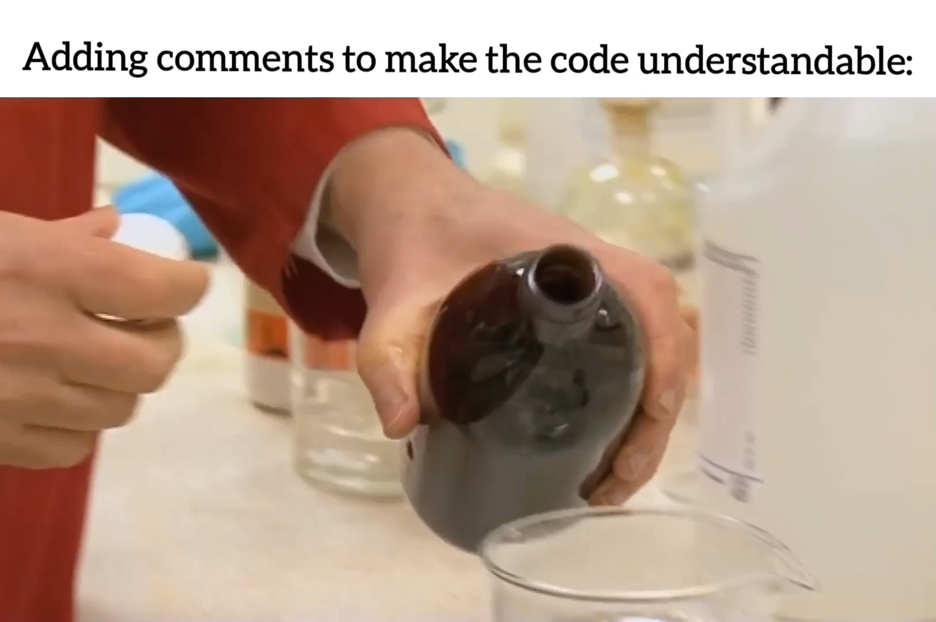
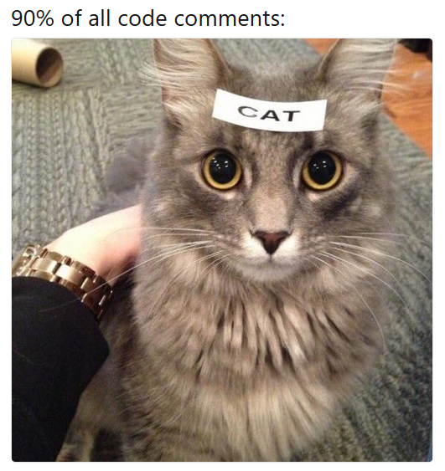
AVOID COMMENTS…
Comments decay exponentially faster than live code
Don’t write comments – rewrite your code
Common smells/anti-patterns
Commenting everything
Version history in a file
Conversation in code
TODO’s that are TODONT’s and never get done
Dead code
“I’ll use this piece of code later” / “I’ll come back and fix this later” / Any type of wishful thinking for later use
Comments clarifying something when a good name would be better
Notes:
Comments are most often overlooked, don’t have IDE tooling around them to enforce naming patterns or references, and so the second the context they’re pointing to changes they’re actually harmful. It’s really confusing to have a comment _not_ match what the code does.
I’m guilty of going through a phase years ago of commenting everything. It’s not helpful and is taxing to write and to read.
Git does versioning better so avoid change mausoleums.
Bob please fix this before 8/11. Track it in your workflow tooling. IDK how else to get this to work, etc. Ask for help on the spot.
Can be a small part of a larger problem. Be introspective as a team as to why these can’t break out of your code and materialize into cards to pay the technical debt.
I have a few quotes later on that really hammer on this but I’ll say this for now – if the code gains value suddenly and you’ve deleted it, you can always pull it out of git. Don’t let it sit though because then it’ll _never_ get deleted. Nobody remembers its original intent and everyone is too afraid to touch it.

Slide 19
… EXCEPT WHEN
Hacks are required
- Open GitHub issues
- Quirks with behavior that are unexpected
- It is a public API that is consumed outside your code’s scope
NuGet packages
Web APIs
This is vital and is mean to exclude this help. Remember the human!
Notes:
Developers create NuGet packages and Web API’s to share code and data flows to other people to help them go faster – and then subject them to undocumented interfaces that undermine the help. You’ll hear me beat this dead horse a lot but help people fall into what is known as a pit of success. Make your easy to use correctly and hard to use incorrectly.

Slide 20
NAMING… AGAIN!?
Coding Smells
Conventions
Ambiguous Names
var cid = 123;
Noisy Names
List<int> listOfCustomerIds = new List<int>()
Instead use
var customerIds = new List<int>()
List<int> customerIds = new() //C#9
Encoded names
Hungarian notation – int32userInfoId
Magic Numbers/Strings
Especially painful for fresh developers
Follow the .NET Conventions
- These are already configured in Visual Studio by default
- PascalCase for public properties
- camelCase for parameters
- _camelCase for private fields
- Avoid abbreviations

Slide 21
LEAN ON YOUR IDE OBEY YOUR LINTER
Keep on top of your IDE warnings
As soon as you ignore them and let them get out of control, you no longer have any warnings.
Listen to your styling guidelines
Visual Studio has a great built-in linter
Code Profile
Alternative – CodeMaid
Other great extensions like CodeCleanupOnSave

Slide 22





MAKE YOUR INTENT KNOWN
Prefer string.Empty over “” for empty strings
Use constructors
Use access modifiers for classes, methods, properties, and fields
Use default values in parameter lists with the default set to the hot path
Testing has its own set of patterns you can use to show what is the system under test and what is unimportant (stub, fake, or mock).
Notes:
Constructors in particular are getting a huge upgrade via a reduction of ceremony with records in c# 9
Making your intent known helps people fall into the pit of success. Make it easy to use your code correctly and hard to use it incorrectly. Good design conveyance

Slide 23

FIRACODE MONOSPACED, LIGATURE-ENHANCED FONTS ARE GREAT FOR READING

Slide 24
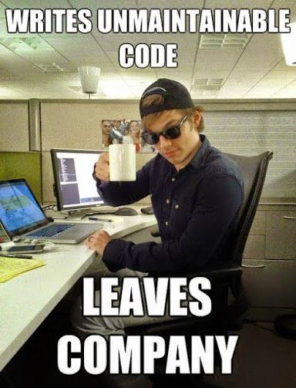
LEAVE A POSITIVE LEGACY
Don’t have your name cursed for years to come by those browsing the annals of commit history

Slide 25
FURTHER YOUR MASTERY
Implementation Patterns (Kent Beck - Book)
Clean Code (Robert Martin - Book)
Clean Architecture (Robert Martin - Book)
Clean Code Youtube Series (Robert Martin)
Udemy Course (Virtual Course)
Clean Code: Part 1(shameless plug for my site)

Slide 26
URGENCY NEVER DIMINISHED, SCHEDULES NEVER REALLY RELAX. WE ALL KNOW, SAYING WE'LL GO BACK AND FIX IT LATER MEANS WE'LL NEVER GO BACK AT ALL.
- Robert Martin

Slide 27
IF YOU DON'T HAVE TIME TO DO IT RIGHT YOU NEVER HAD TIME TO DO IT AT ALL.
- Robert Martin

Slide 28
IT IS OKAY TO SLOW DOWN AND THINK OF YOUR CODE’S IMPACT ON YOURSELF AND OTHERS TAKING FIVE MINUTES WILL NEVER HURT FAILING TO DO SO IS MERELY DEFERRING THE COST TO LATER – WITH ACCUMULATED INTEREST WE LIVE IN THE HOUSES WE BUILD – DON’T MAKE SACRIFICES TO YOUR CODE YOU AREN’T WILLING TO LIVE WITH FOREVER
EVERYONE IS CAPABLE OF WRITING DIRTY CODE WITHOUT THE PROPER TIME
Notes:
- You and your team OWN what you write.

